Slide 1



Priority Access for Traffic Handling (P.A.T.H): Optimizing Emergency Response in Smart Cities
Group 2:
Nuno Baptista, 96295
Francisco Matias, 99936
Francisco Oliveira, 99939
Hugo Rabuge, 99959
Miguel lourenço, 100037

Slide 2





A brief Story…
Joana's Daily Struggle
A Devastating Delay
Collaboration and Innovation
Everyday challenges of navigating congested city streets.
A life was lost due to an unexpected traffic jam.
Joana teams up with engineers to find a solution.
PATH in Action
A Life Saved
The new system allows the ambulance to reach the scene in minutes.
The new system proves its worth, saving lives.

Slide 3
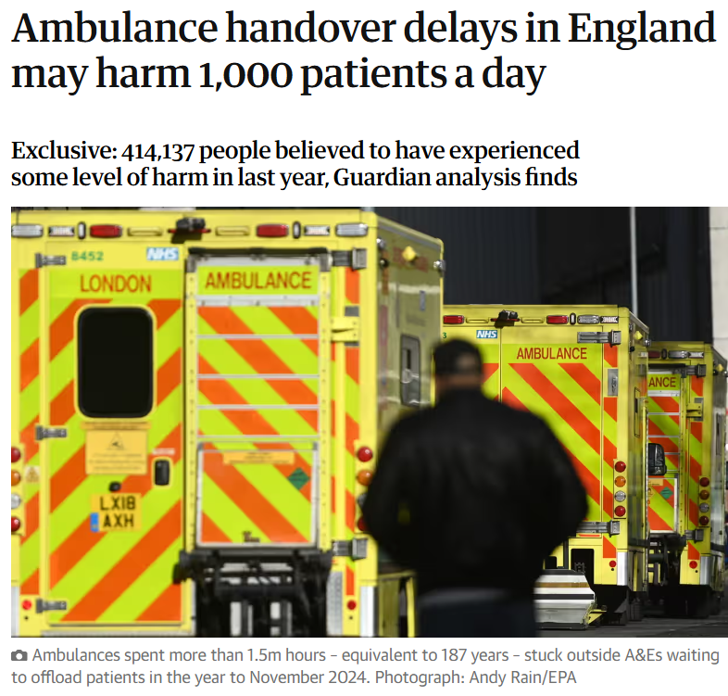
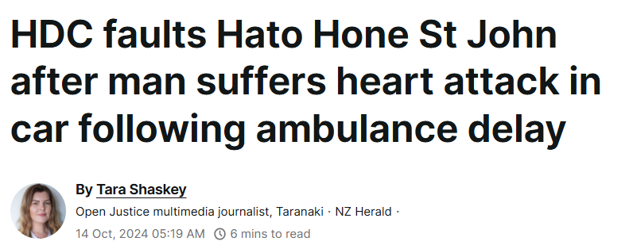
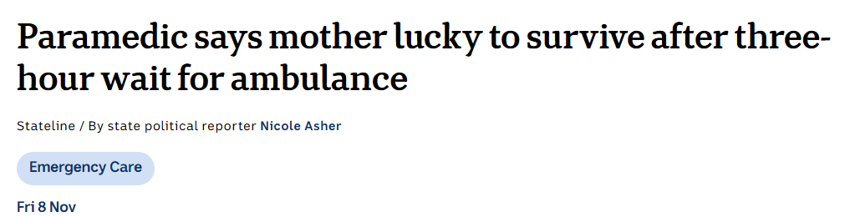
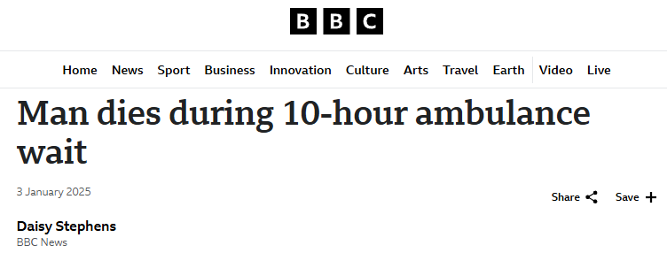

Slide 4
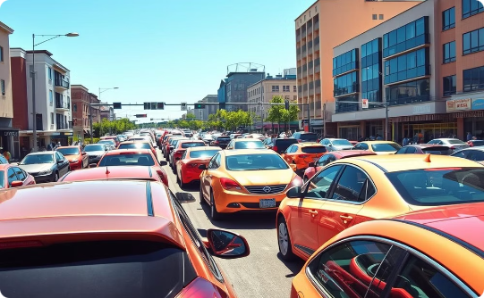
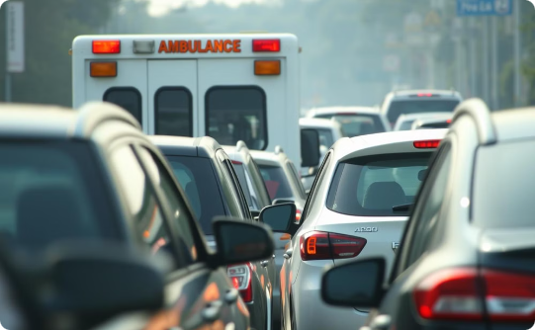

The Problem:
Traffic Congestion
Limited Accessibility
Lives at Stake
Dense urban environments often result in significant traffic congestion, especially during peak hours.
Emergency vehicles struggle to navigate through congested areas, delaying their arrival at the scene.
Every minute counts in emergency situations. Delays in response time can have dire consequences.

Slide 5
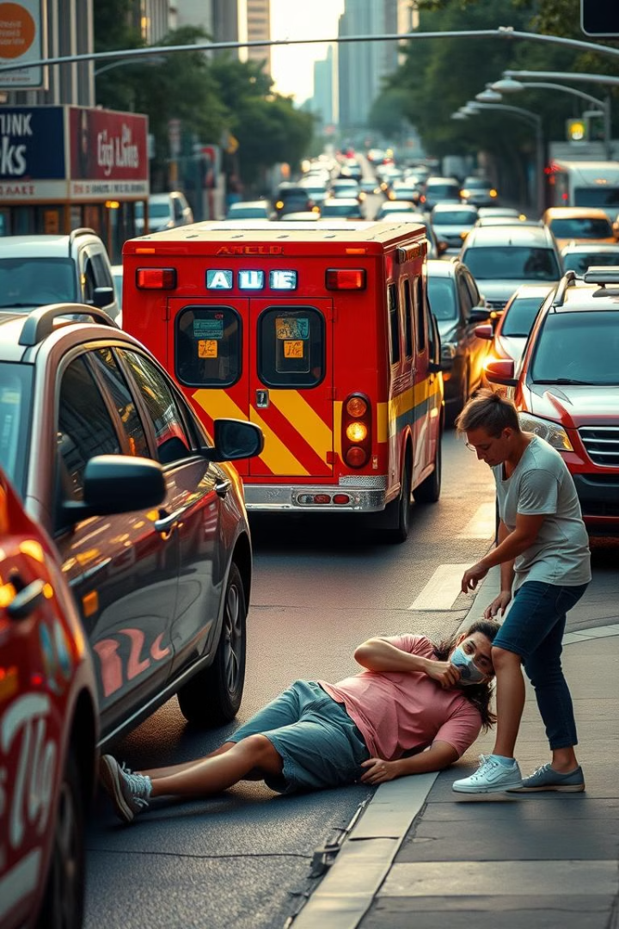
The Problem:
Emergency vehicles take too long to reach the scene due to poor accessibility in highly populated areas. It can cost a life!

Slide 6

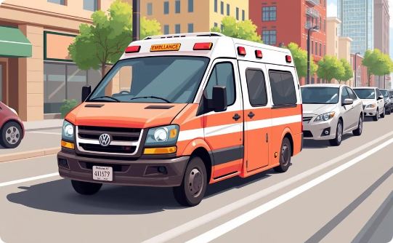
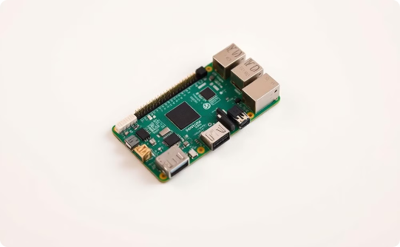
Our Solution: Material Used
Traffic Lights
Vehicles
Raspberry Pi
Used for dynamic traffic control.
One emergency vehicle and multiple normal cars.
The processing unit at the heart of the system.

Slide 7
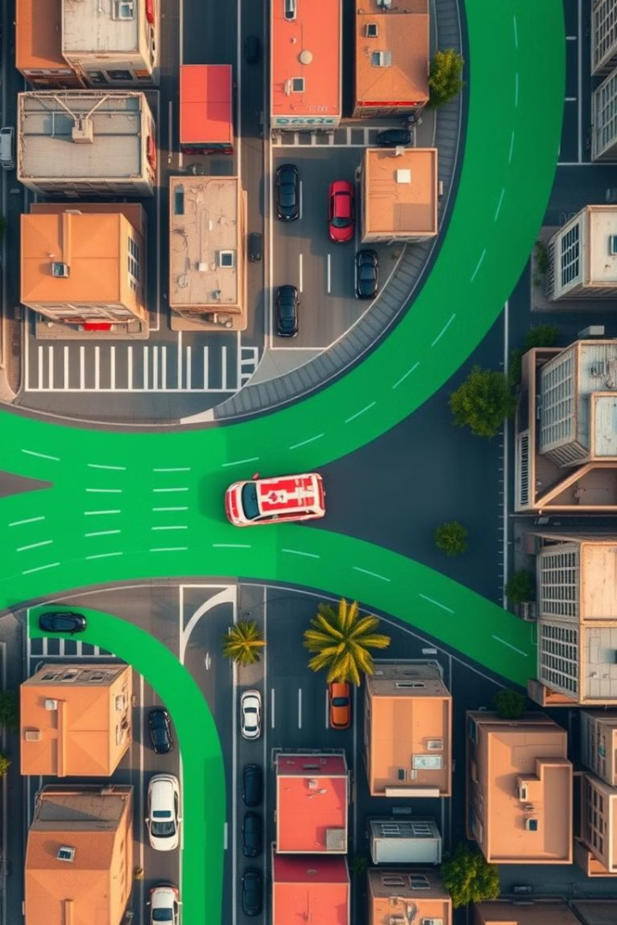
Our Solution: P.A.T.H
Optimizes emergency vehicle access by dynamically clearing paths in real-time, using an autonomous system, improving response times and saving lives.

Slide 8
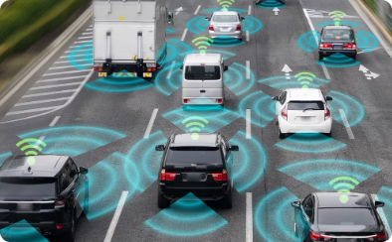
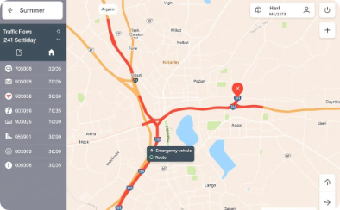
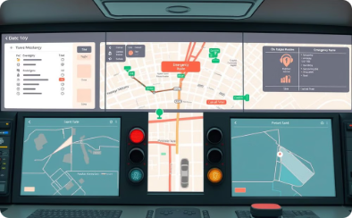
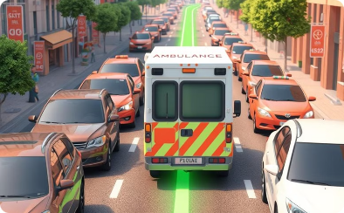
Our Solution:
Vehicle-to-Vehicle (V2V) Communication
Real-time Traffic Data Sharing
RSU Control
Priority Acess
The RSU (Roadside Unit) receives alerts and controls vehicle routes and traffic signals.
P.A.T.H prioritizes the movement of ambulances, fire trucks, and other emergency vehicles.
Real-time traffic data enables optimal and dynamic path selection.
Real-time communication between vehicles enables better decisions like velocity adjustments without accidents.

Slide 9
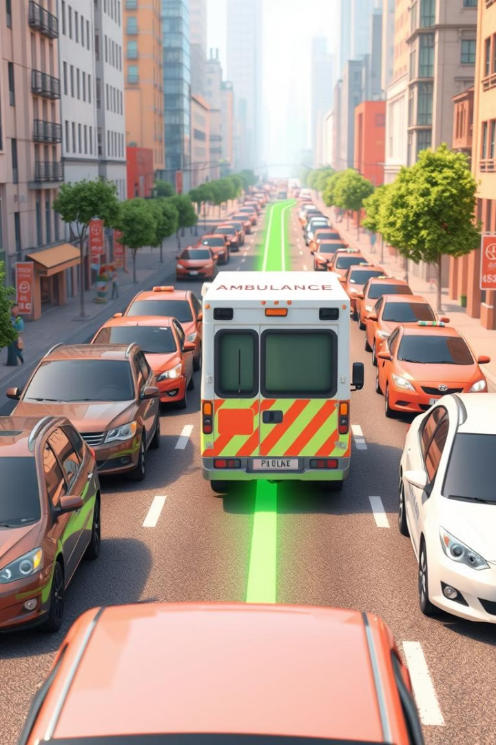




Use Case: Clearing the Way for Ambulances and Fire Trucks
Emergency Call
An emergency call is received, triggering P.A.T.H. to activate.
Real-time Analysis
The system analyzes traffic patterns to identify the fastest route to the scene.
Traffic Control
Traffic signals are adjusted, and vehicles are redirected to clear a path for the ambulance.
Efficient Arrival
The ambulance arrives at the scene quickly and efficiently, saving valuable time.

Slide 10
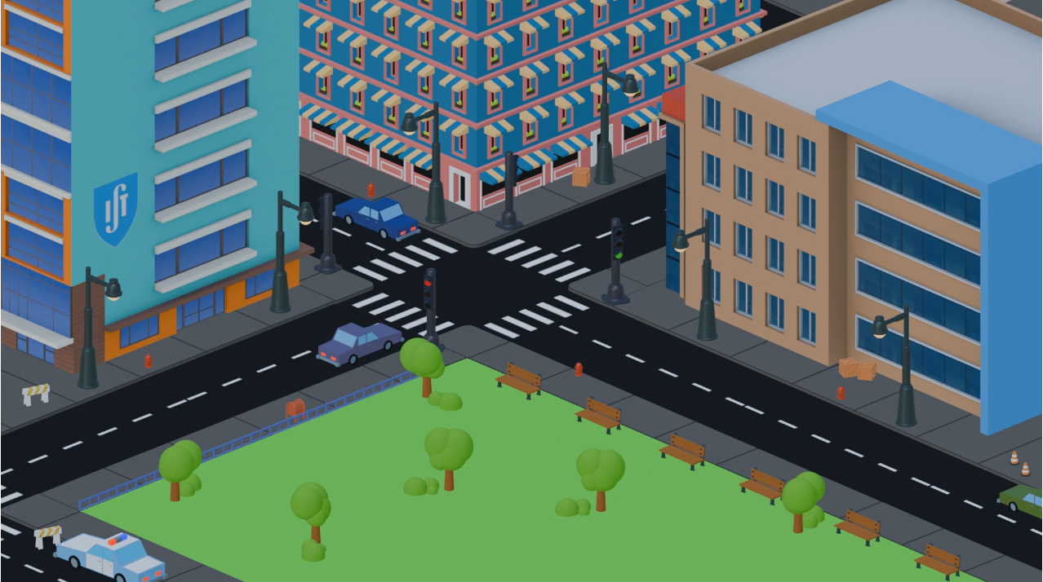
Simulation Video: Showcasing P.A.T.H. in Action

Slide 11
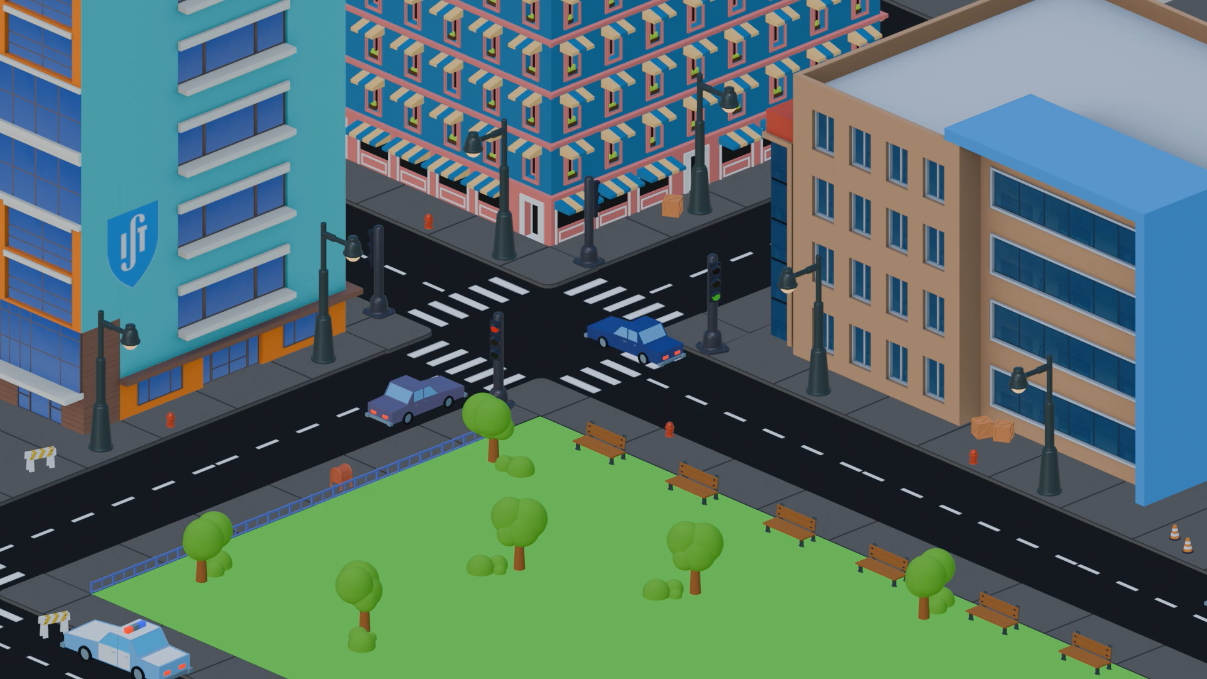
Simulation Video: Showcasing P.A.T.H. in Action

Slide 12
Thank You!

